Slide 1


College of Micronesia-FSM
FINANCIAL STATUS REPORT
December 12, 2023
Students today, Leaders Tomorrow

Slide 2


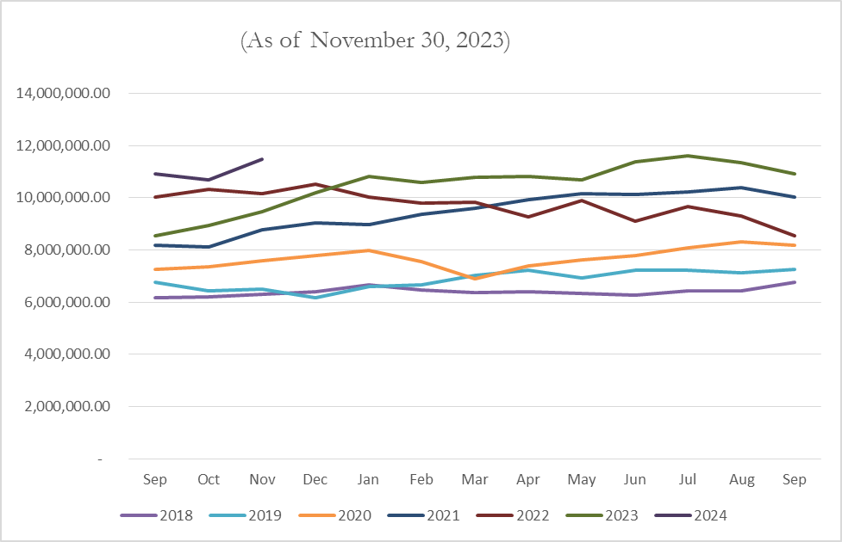
A. Endowment Fund
The endowment fund increased by 5% or $574K due to unrealized market gain since October 01, 2023.

Slide 3
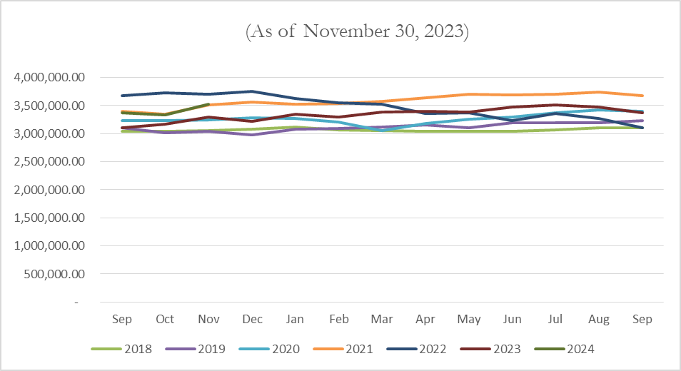
B. Cash Reserves
The cash reserves fund increased by 5% or $154K due to unrealized market gain since October 01, 2023.

Slide 4
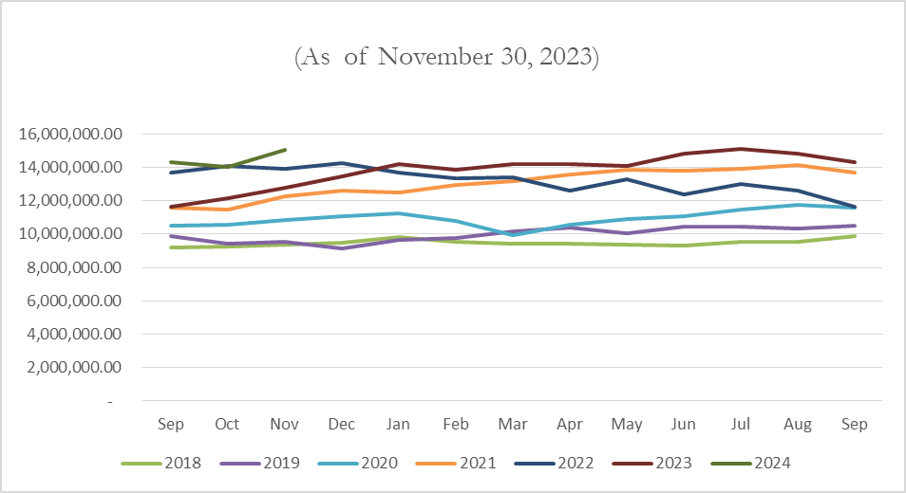
C. Total Investment
The total investment increased by 5% or $728K due to unrealized market gain since October 01, 2023.

Slide 5
D. Cash in Bank Balance as of November 30, 2023
Bank of Guam - $1.381M
Bank of FSM - 3.024M
Total $4.405M

Slide 6
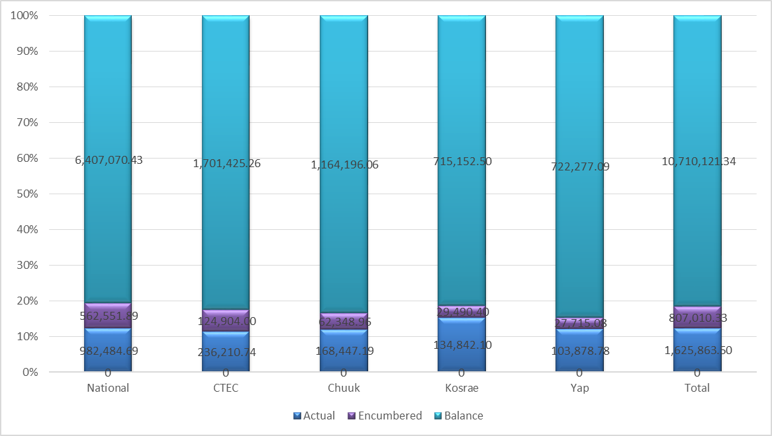
E. FY 2024 Budget Balance as of November 30, 2023

Slide 7
E.1 FY 2024 Budget Balance as of November 30, 2023

Slide 8
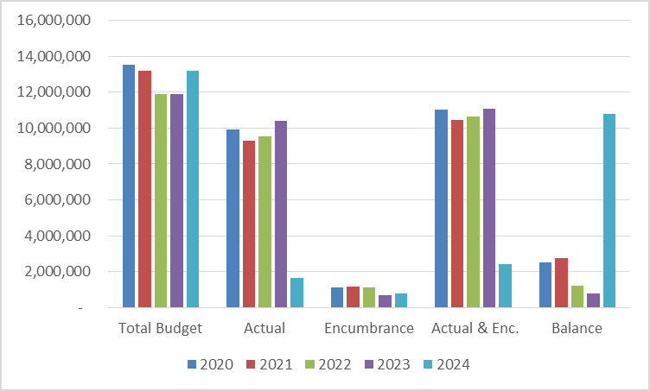
F. Comparative Budgets & Expenses

Slide 9
F.1 Comparative Budgets & Expenses

Slide 10
G. FY2022 Audit Report Status

Slide 11
E.1 FY 2024 Financial Challenges:
1. FSM Government Support
-$2M appropriated instead of $4M
- Cash Reserves might be used if no additional funding will be given to the college
2. Pending Grant money due to late audit report
- TRIO
- Teaching Clinic Construction
3. Steady decline in enrollment
4. Rising operating cost (utilities, supplies, equipment)

